Slide 1
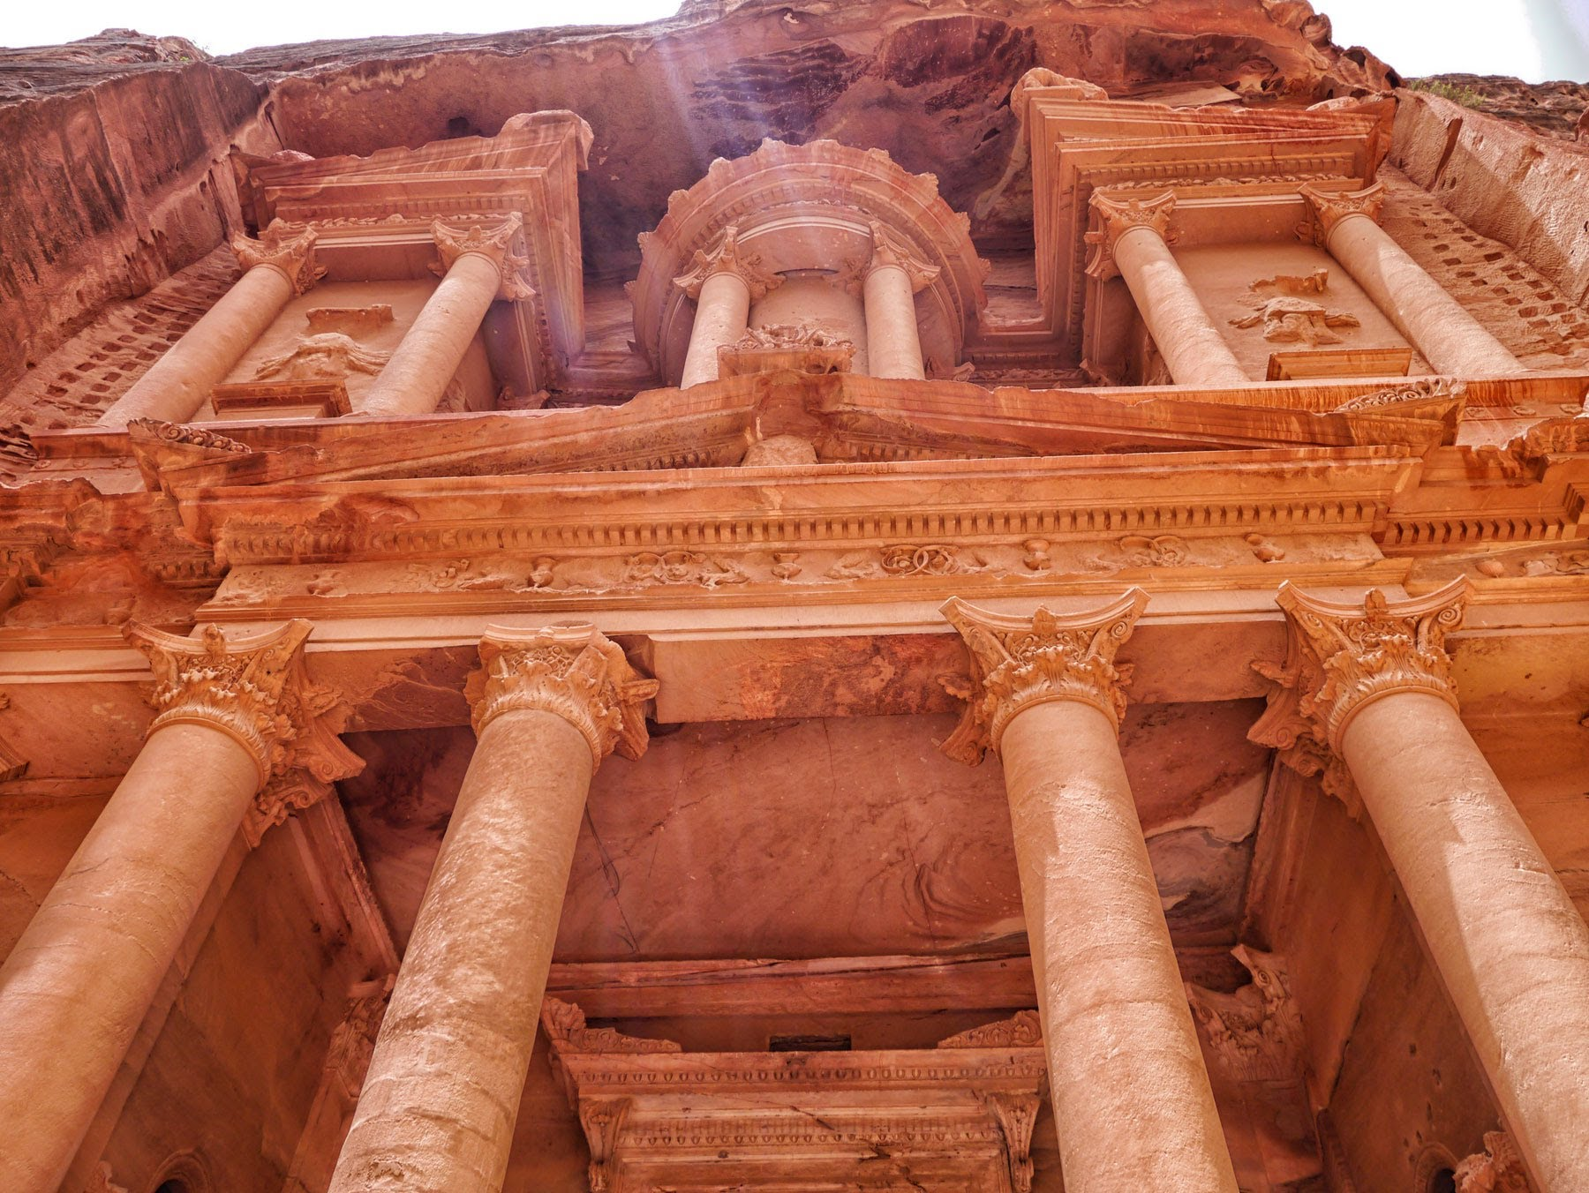
PETRA
The Rose City

Slide 2
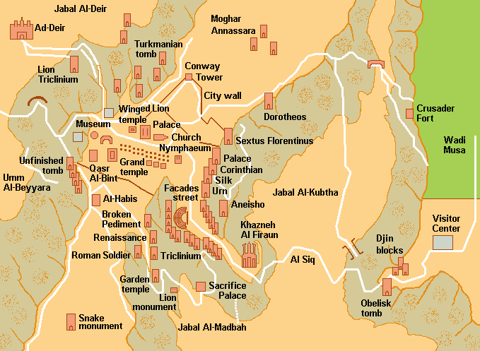
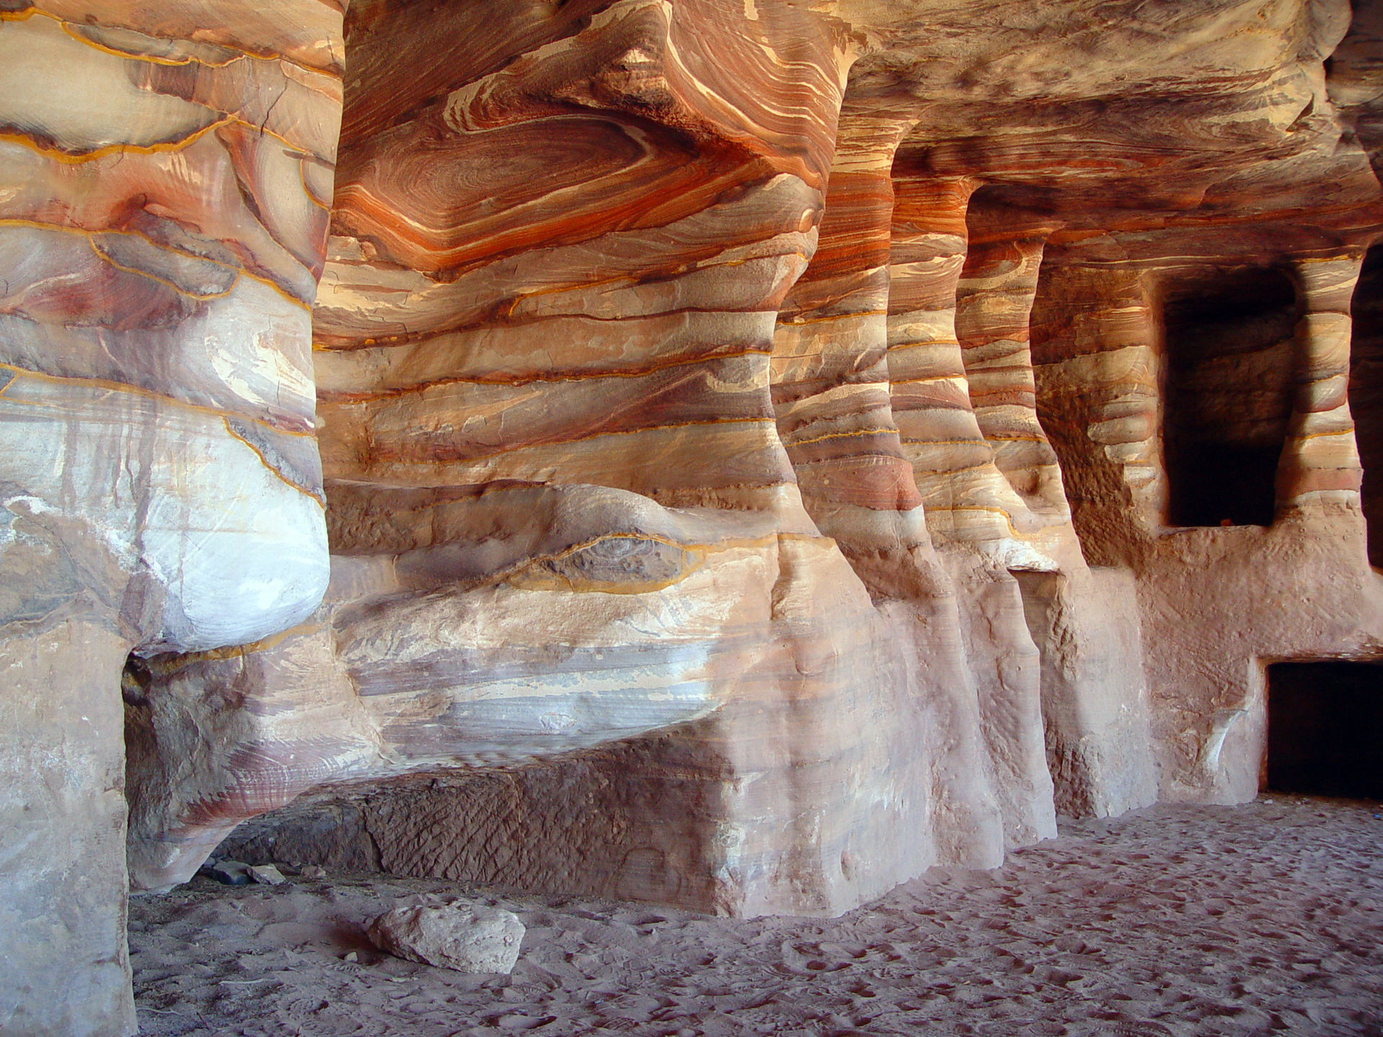
History
Capital of Nabataen Empire
-Combination of Arab State
Hellenistic and Roman times
-Caravan trade center
-Crossroads
AD 106- Conquered by Roman Empire
-Roman Province of Arabia
Wealth declined
-Alternate trade routes
“Rediscovered” in 1812
-Johan Ludwig Burkhardt
- People still lived in area

Slide 3
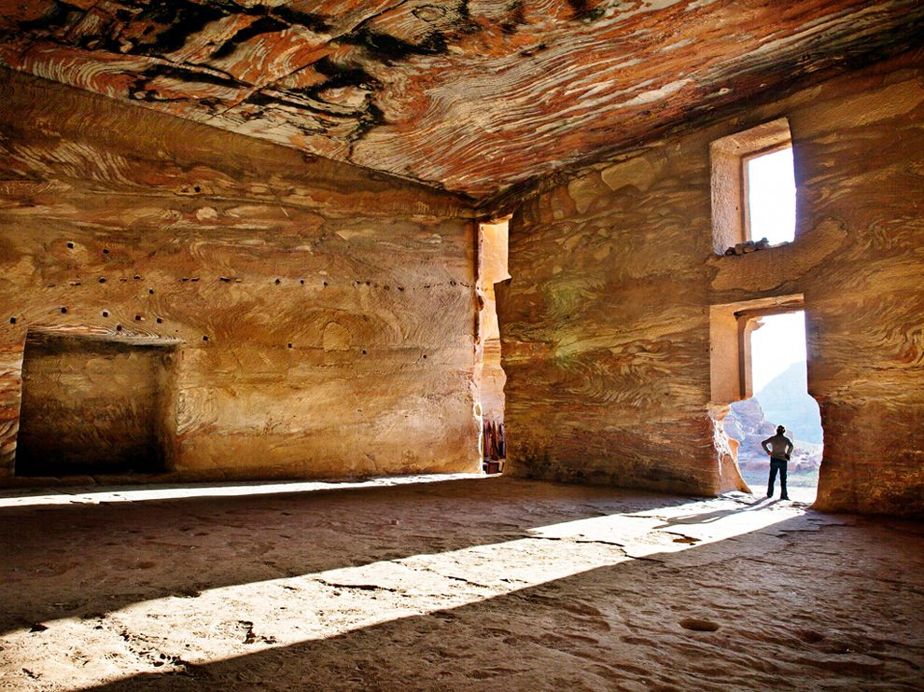
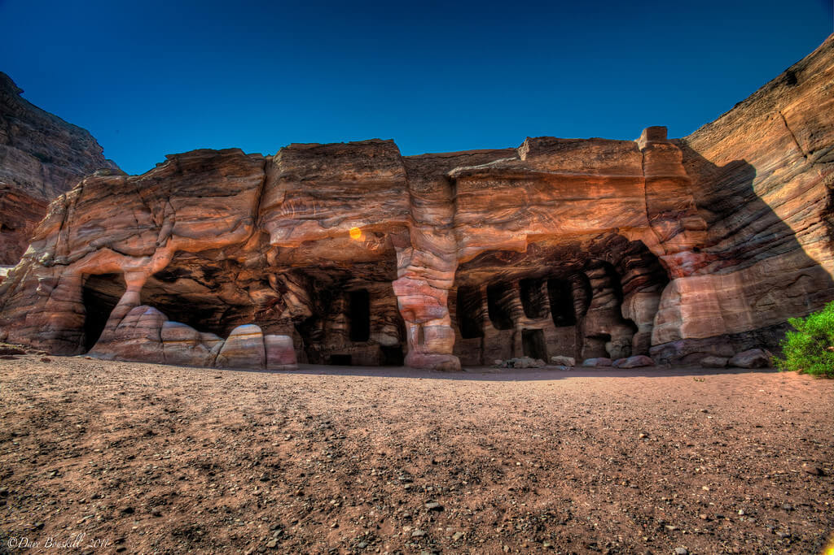
Importance
Networks of water capture, storage, transport, and irrigation systems still exist
Extensive elaborate architecture & archaeological remains
Fusion of Hellenistic architectural facades with traditional Nabataean rock-cut
UNESCO World Heritage Site 1985
Excavations ongoing
85% still unexcavated

Slide 4
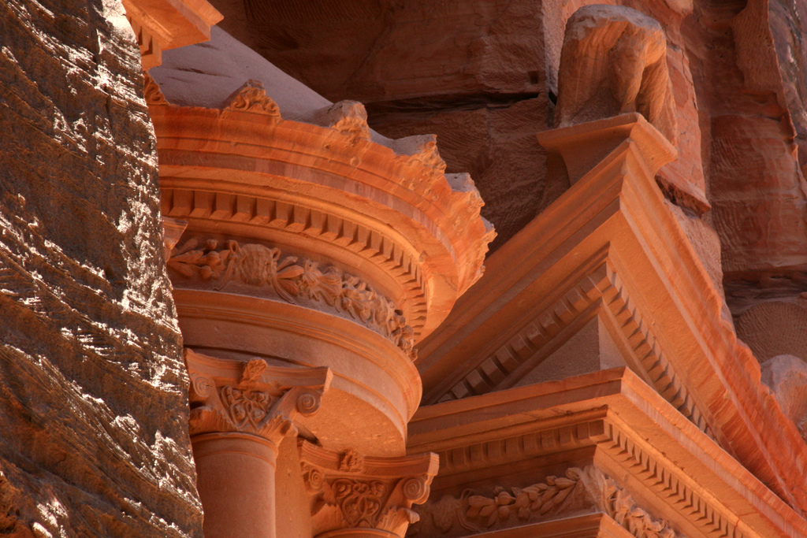
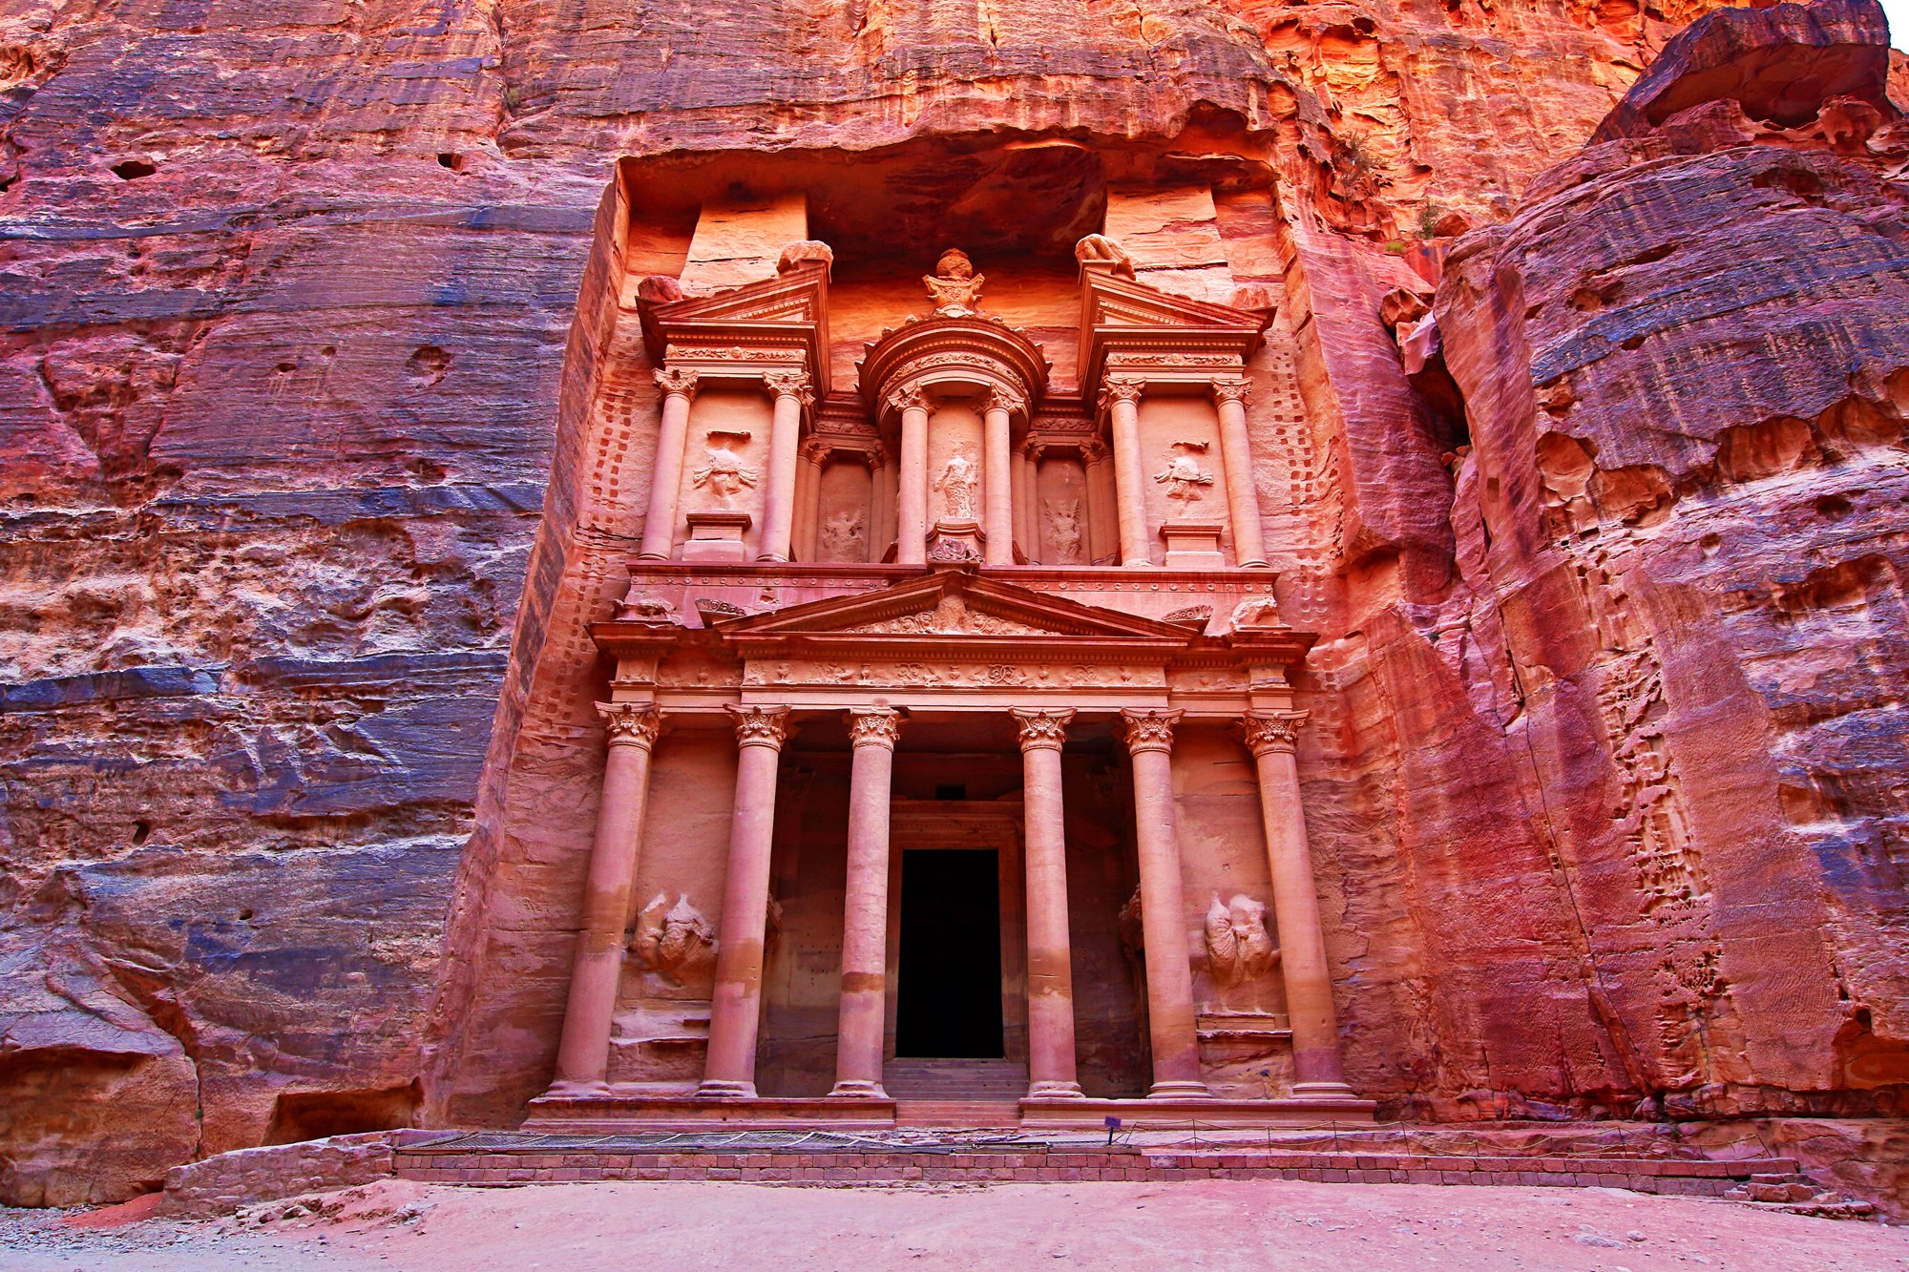
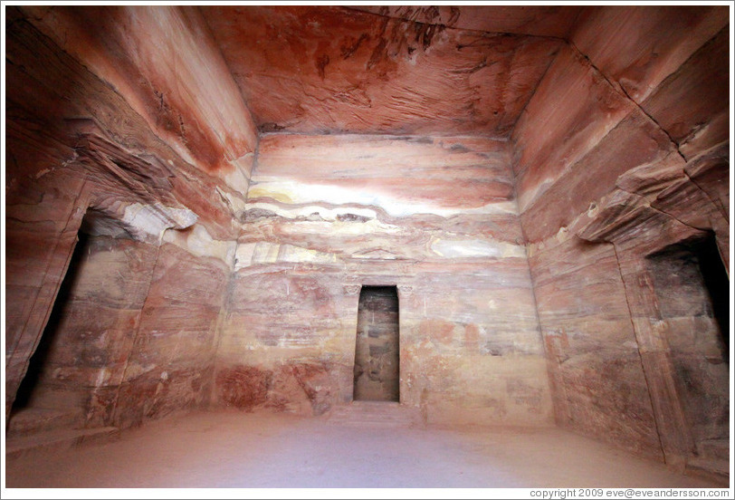
Treasury
40 Meters high (131 ft.)
Intricately decorated
Friezes, figures, & Corinthian Capitals
Funery urn
Inside consists of three chambers
Original purpose unknown
Temple, document storage
Recent Excavations

Slide 5
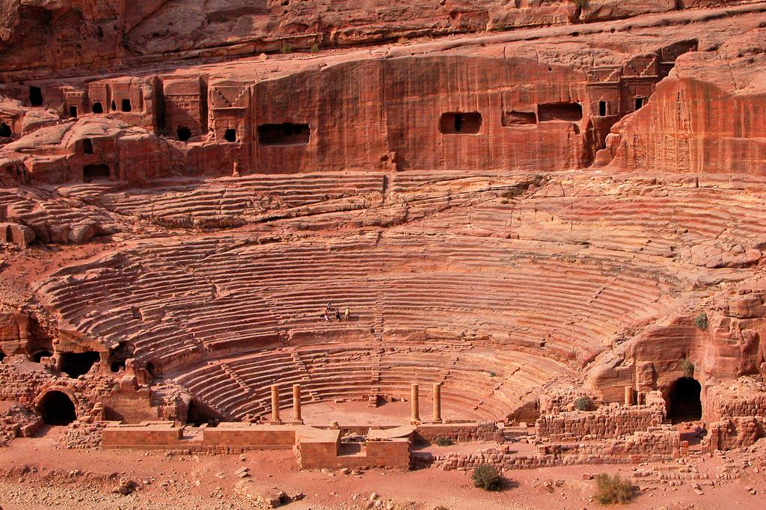
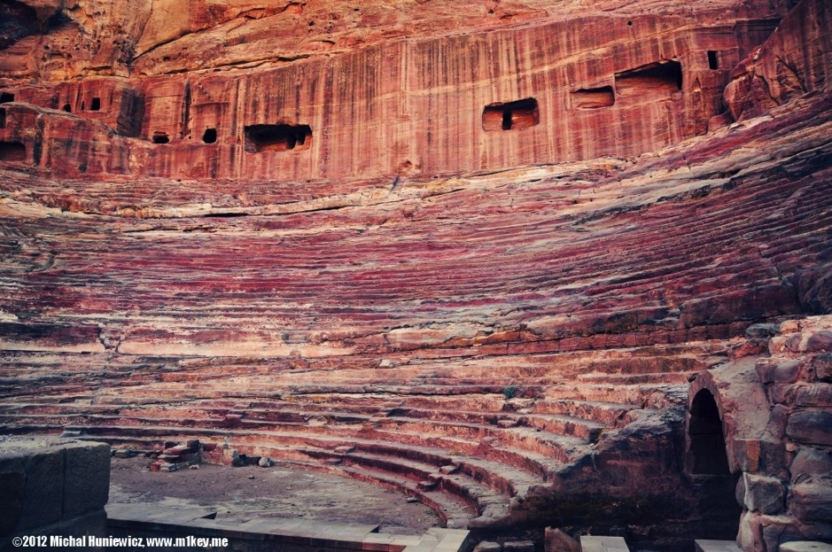
Theatre
Carved into mountainside
Three rows of seats separated by passageways
-Seven stairways
- 4,000 spectators
Romans rebuilt the stage back wall

Slide 6
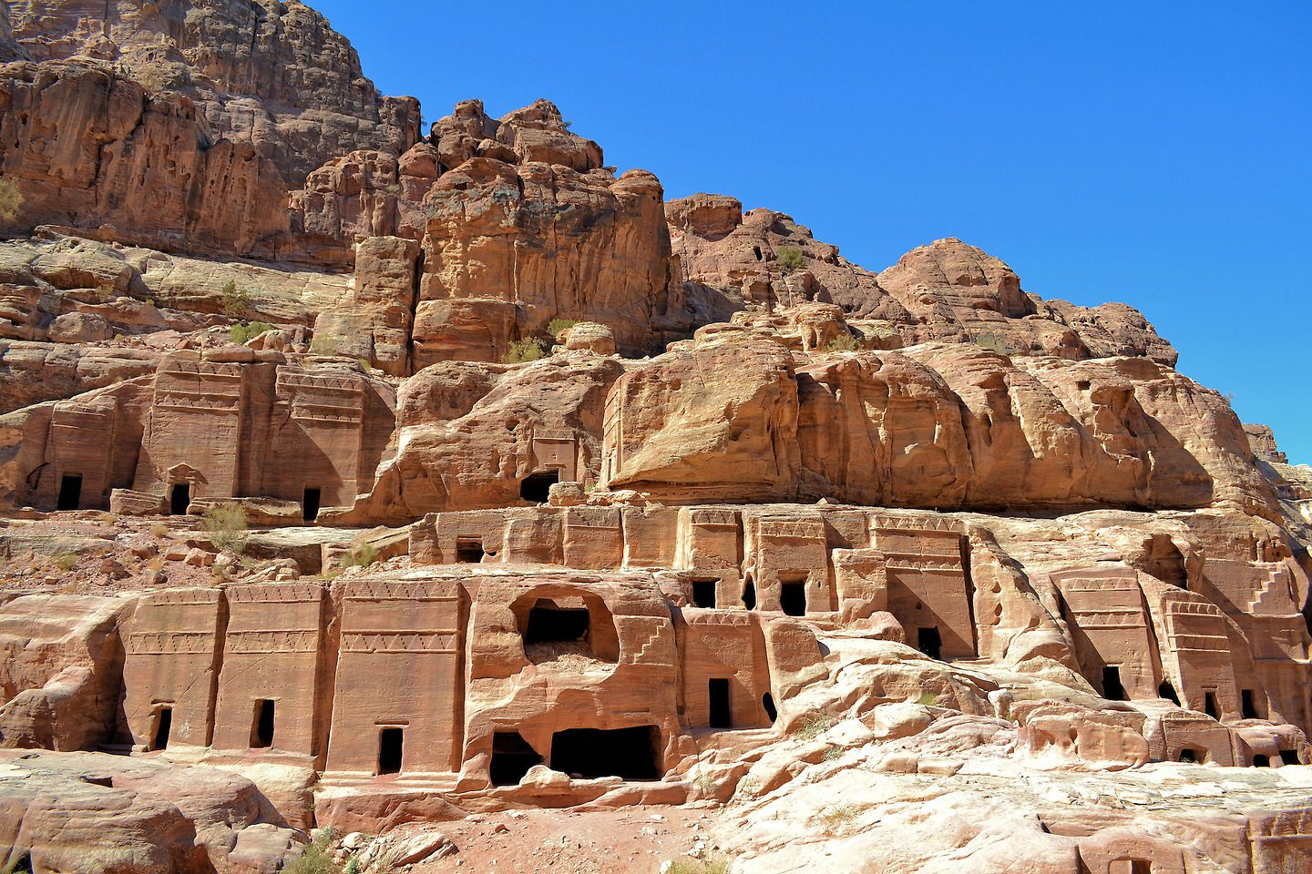
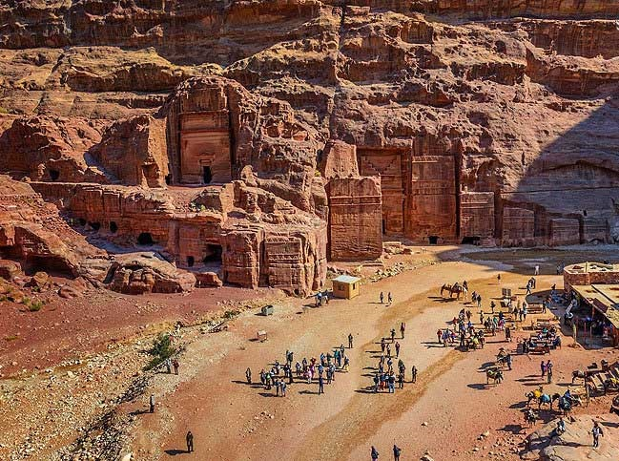
Street of Facades
Monumental Nabataen tombs carved in cliff
- Tombs of courtiers in the middle of the first century AD
Tomb of Anesho
- Queen‘s minister

Slide 7
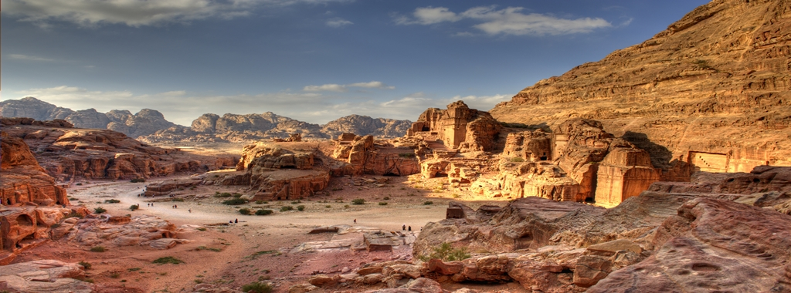

Slide 8
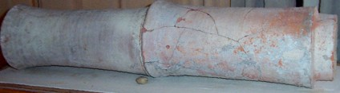
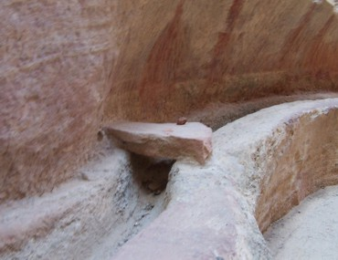
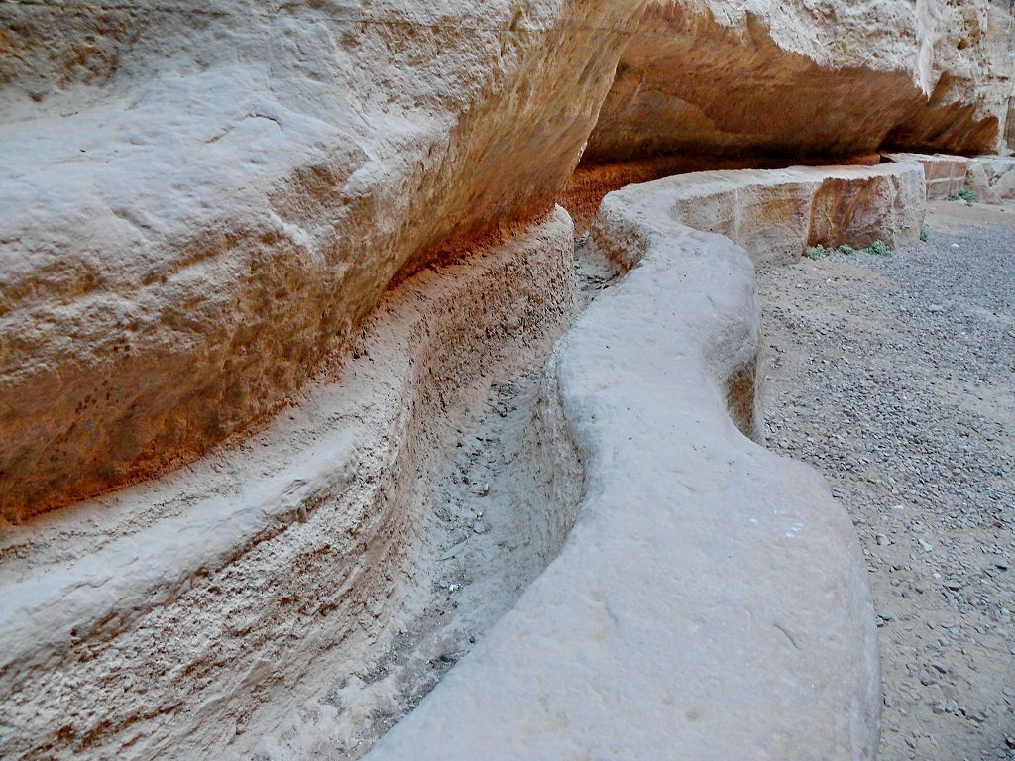
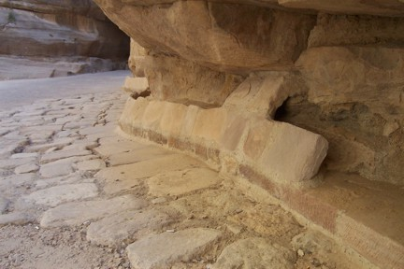
Water system
Engineering capability
Skill in solving complex hydraulic problems
Network of key cisterns, dams, springs, channels & pipelines
Continuous flow pipeline systems
- Maintained a constant water supply through wet and dry seasons
Analysis of the Nabataean water network:
- Use of multiple particle-settling basins to purify water
- Flow rates of water and pipe design protect from leakage

Slide 9
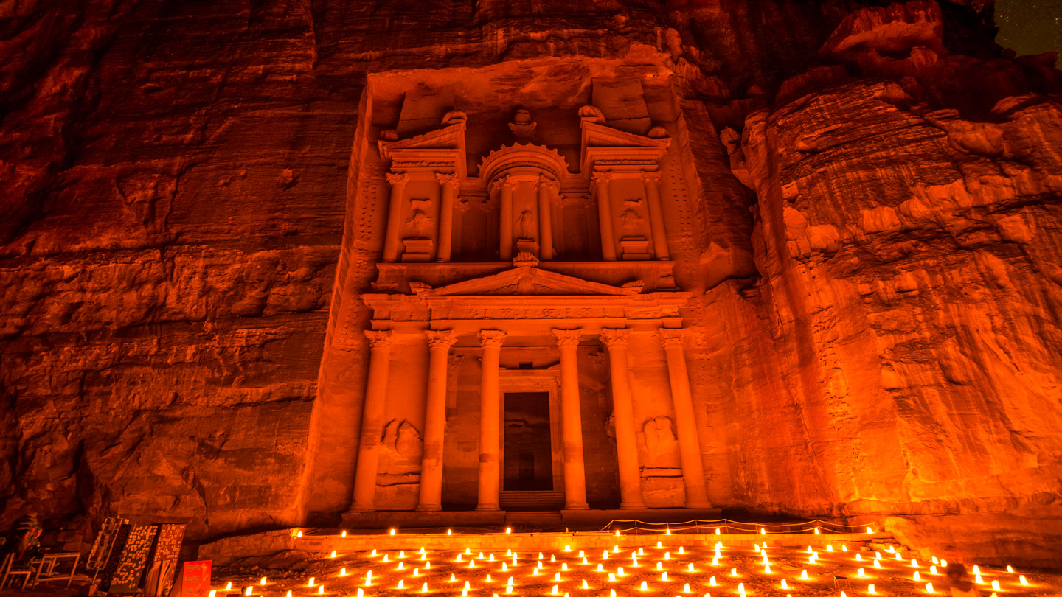
Works Cited
https://www.cambridge.org/core/journals/cambridge-archaeological-journal/article/water-supply-and-distribution-system-of-the-nabataean-city-of-petra-jordan-300-bc-ad-300/96C92EBE64E36A3DEB7574786AEB36FE
http://www.visitpetra.jo/Pages/viewpage.aspx?pageID=157
http://petranationaltrust.org/SubDefault.aspx?PageId=186&MenuId=22
https://www.nationalgeographic.com/archaeology-and-history/archaeology/lost-city-petra/#close
http://whc.unesco.org/en/list/326
http://nabataea.net/ppark.html

